Slide 1
How big is a mole?
Notes:
This PP uses a local beach and the students’ ability to think to give them some idea of exactly how big one mole is.

Slide 2

For part of their CAS programme some of our students act
as lifeguards on our local beach (Southerndown beach).
Notes:
If you can provide your own picture of a beach near you that your students know – so much the better

Slide 3
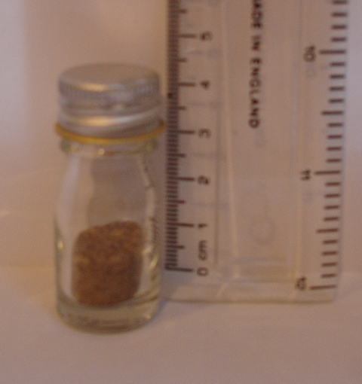
Here is some sand taken from the beach
Notes:
Again it is better to provide your students with an actual bottle of sand (you can take it from anywhere!)

Slide 4

This is a picture of the beach taken from the cliffs above. Can you ‘guesstimate’ from the information contained in this picture and the picture before how many grains of sand there are on Southerndown beach? No calculators allowed!
Notes:
It is a bay so the rocks come round again to the right of the picture (the distance is about 1 km but let them work that out!)

Slide 5
Volume of sand on Southerndown beach
= (1 x 10³) x (1 x 10²) x 1 m³
= 1 x 10⁵ m³
1 cm³ contains 1 x 10³ grains of sand
1 m³ = 1 x 10⁶ cm³
Hence 1 m³ contains 1 x 10⁹ grains of sand
Number of grains of sand on Southerndown beach
= 1 x 10¹⁴
Nowhere near one mole of sand.
So where can we find a bigger beach?
Notes:
It is sensible when guesstimating to keep the numbers simple. Hence the length of the beach is estimated to be 1 km (from the size of the people) and the distance from the cliff to the sea 100 m. The depth can be guessed as 1 m from the fact that rocks are visible.
From the previous picture we can guesstimate that there are 1000 grains of sand in 1 cm³
Make the point that even if the distances are wrong say 2 km instead of 1 km in length then the power of ten remains the same.

Slide 6
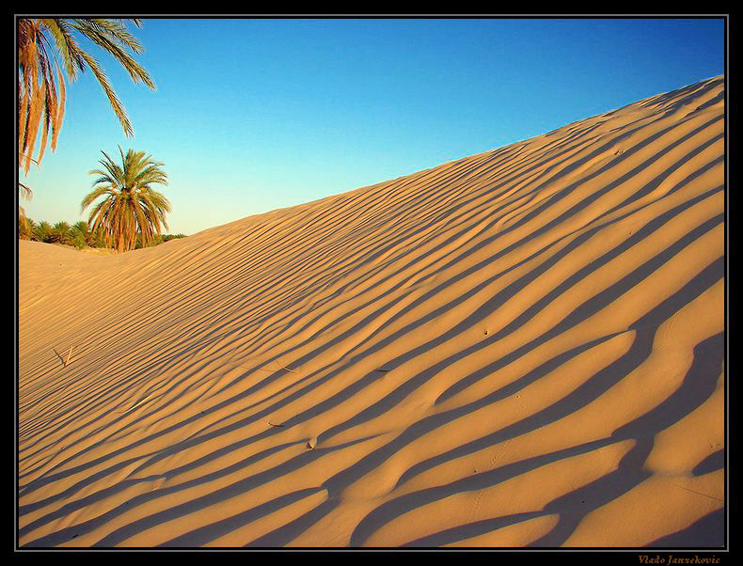
The Sahara Desert

Slide 7
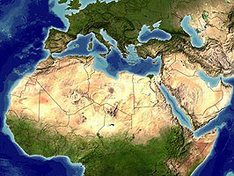
^
1 500 km
v
SAHARA DESERT
←-------------4 000 km---------->

Slide 8
Volume of Sahara desert
= (4.0 x 10⁶) x (1.5 x 10⁶) x 10 m³
= 6.0 x 10¹³ m³
1 cm³ contains 1 x 10³ grains of sand
Hence 1 m³ contains 1 x 10⁹ grains of sand
Number of grains of sand in the Sahara desert = 6 x 10²²
That is, about 1/10 mole of grains of sand

Slide 9
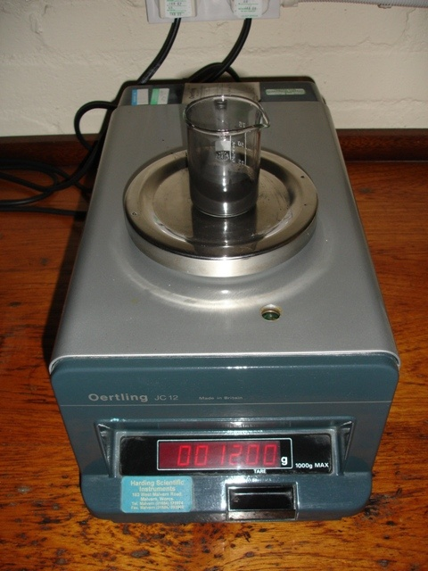
12 g of carbon
1 mole of carbon
6.02 x 10²³ atoms of carbon
Notes:
Show students one mole of some elements e.g. 63.5 g of copper or 27.0 g of aluminium. I like to also show them 12.0 g of carbon. The point being that there are more atoms of carbon in 12 g of carbon than there are grains of sand in the whole of the Sahara Desert.

